Slide 1
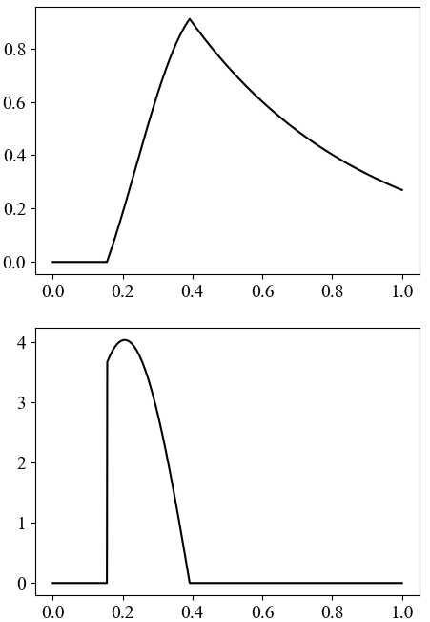







Iwasa, Hayashi, Satake
Fig. 1
$$V\left(t\right)$$
BVOC concentration
$$s\left(t\right)$$
BVOC production
$$t1$$
$$t2$$
$$T$$
$$t$$
$$p=16, u=0.01, a=4, k=2$$

Slide 2
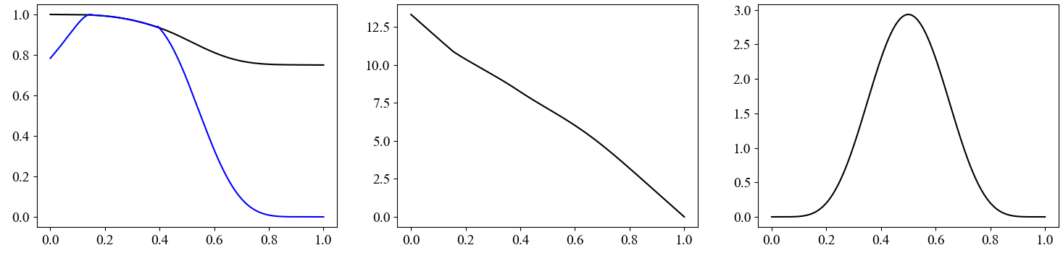








Iwasa, Hayashi, Satake
Fig. 2
(a)
(b)
(c)
$$λ_{V}=L$$
$$L$$
$$λ_{L}$$
$$h$$
$$λ_{V}$$
$$T$$
$$T$$
$$T$$
$$t$$
$$t$$
$$t$$

Slide 3
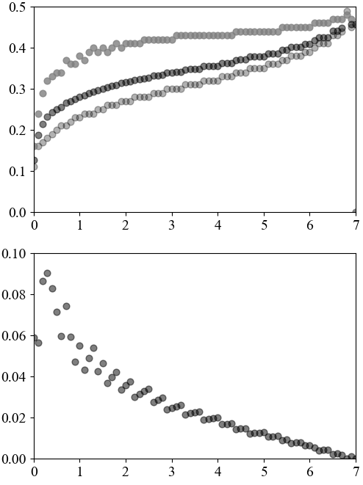
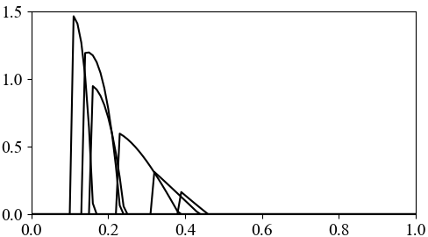













Iwasa, Hayashi, Satake
Fig.3
(b)
$$t$$
(a)
$$t_{2}$$
$$k=0$$
$$t_{bar}$$
$$k=0.05$$
$$t_{1}$$
$$k=0.1$$
$$k=1$$
$$k=4$$
$$k$$
$$k=6$$
(c)
$$S_{total}$$
$$t$$
$$k$$

Slide 4
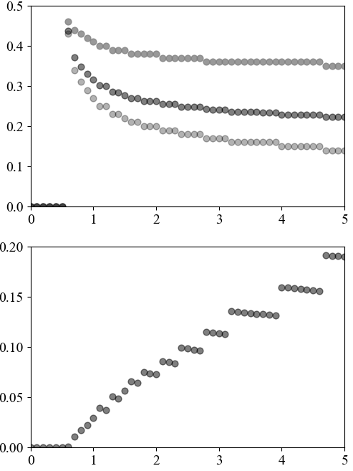





Iwasa, Hayashi, Satake
Fig.4(a)(b)
(b)
$$t$$
(a)
$$t_{2}$$
$$t_{bar}$$
$$p=1$$
$$p=4$$
$$t_{1}$$
p
(c)
$$S_{total}$$
p

Slide 5
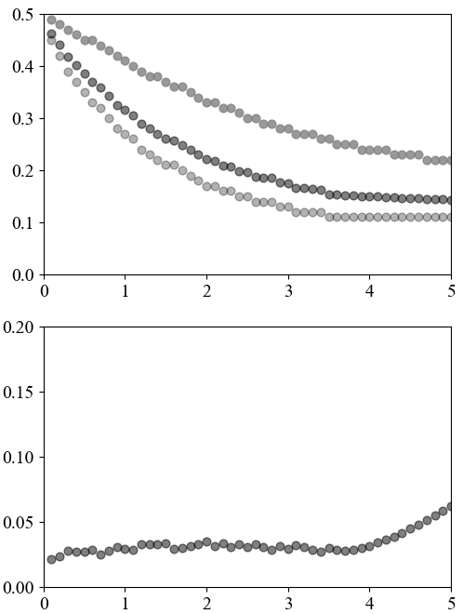



Iwasa, Hayashi, Satake
Fig.4(c)(d)
(c)
(b)
$$t$$
$$t_{2}$$
$$t_{2}$$
$$t_{bar}$$
$$t_{bar}$$
$$t_{1}$$
$$t_{1}$$
H_{total}
p
(c)
$$S_{total}$$
$$S_{total}$$
H_{total}
p

Slide 6
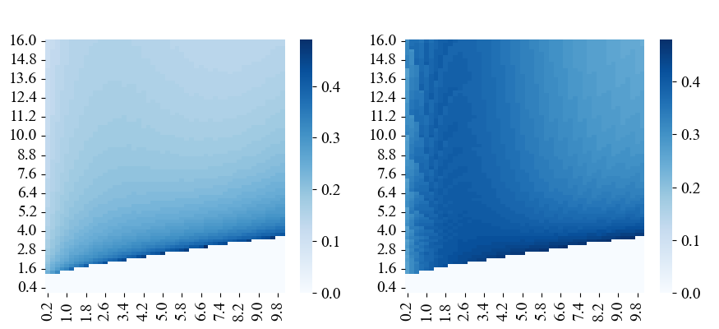





Iwasa, Hayashi, Satake
Fig.5(a)(b)
(a)
(b)
$$t_{1}$$
$$t_{2}$$
photosynthetic rate
$$p$$
no BVOC
no BVOC
$$k$$
$$k$$
decay rate
decay rate

Slide 7
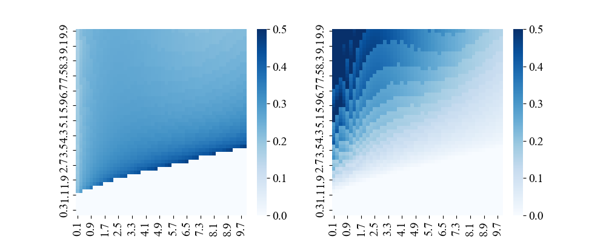





Iwasa, Hayashi, Satake
Fig.5(c)(d)
(c)
(d)
$$t_{bar}$$
$$S_{total}$$
photosynthetic rate
$$p$$
no BVOC
no BVOC
$$k$$
decay rate
$$k$$
decay rate

Slide 8
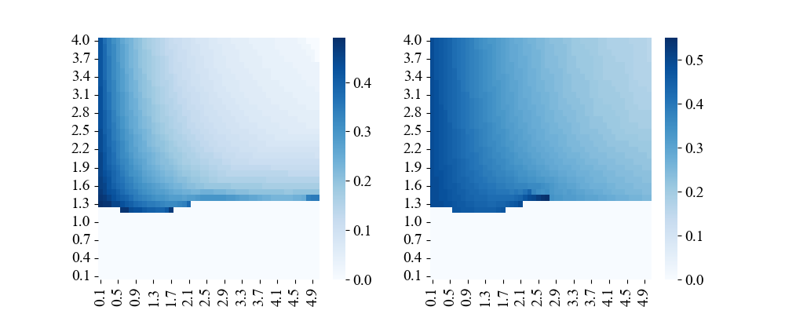




Iwasa, Hayashi, Satake
Fig.6(a)(b)
(a)
(b)
$$t_{1}$$
$$t_{2}$$
photosynthetic rate
$$p$$
$$Htotal$$
$$Htotal$$
total stress
total stress
no BVOC production for small p

Slide 9
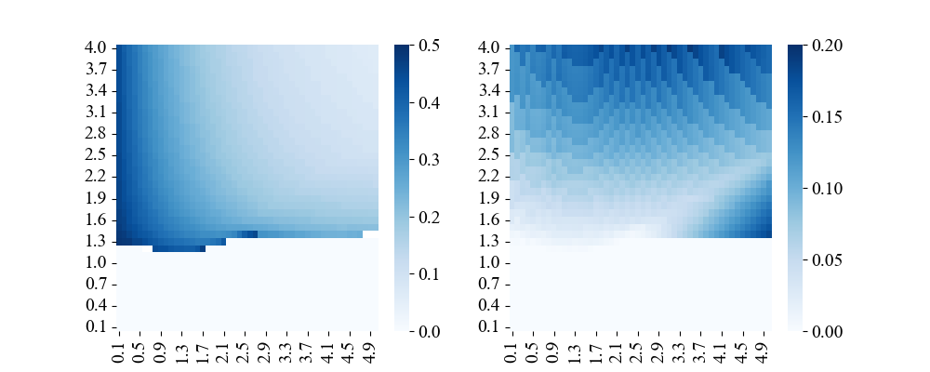





Iwasa, Hayashi, Satake
Fig.6(c)(d)
(c)
(d)
$$t_{bar}$$
$$s_{total}$$
photosynthetic rate
$$p$$
$$Htotal$$
$$Htotal$$
total stress
no BVOC production

Slide 10






Iwasa, Hayashi, Satake
Fig.7(a)
作成中
(a)
$$V\left(t\right)$$
$$s\left(t\right)$$
$$L\left(t\right)$$
$$λ_{L}\left(t\right)$$
$$λ_{V}\left(t\right)$$
$$p\left(t\right)$$

Slide 11

Iwasa, Hayashi, Satake
Fig.7(b)
作成中
(b)
$$V\left(t\right)$$
$$s\left(t\right)$$
$$L\left(t\right)$$
$$λ_{L}\left(t\right)$$
$$λ_{V}\left(t\right)$$
$$k\left(t\right)$$

Slide 12
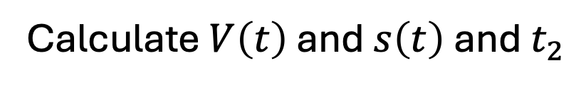
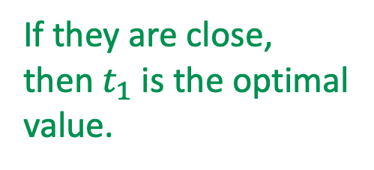
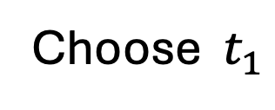
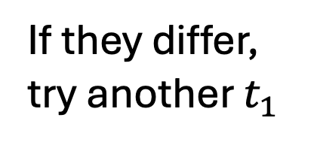


この図はsupplementary materialにあるappendixにいれます
Iwasa, Hayashi, Satake
Fig.S1(a)
(a)
Choose $t_{1}$
[1] use dV/dt obtained before
Calculate $V\left(t\right)$ and $s\left(t\right)$ and $t_{2}$
[2] use d$L$/dt
[3] use d$λ_{V}$/dt and d$λ_{L}$/dt
Calculate $L\left(t\right)$
Calculate $λ_{V}\left(t\right)$ in phase III
$$L\left(t_{s}\right){=λ}_{V}\left(t_{2}−0\right)$$
$$λ_{V}\left(t_{2}+0\right)$$
If they differ,
try another $t_{1}$
If they are close,
then $t_{1}$ is the optimal
value.

Slide 13
この図はsupplementary materialにあるappendixにいれます
Iwasa, Hayashi, Satake
Fig.S1(b)
(b)
t
T
t
T
2
2
optimal
t₁
t
T
2

Slide 14
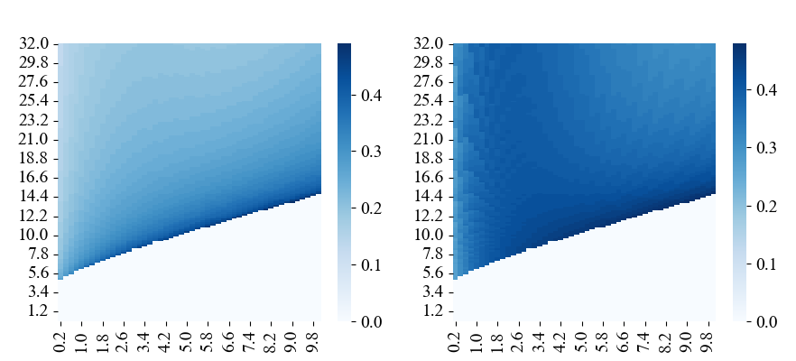


Iwasa, Hayashi, Satake
Fig.5(a)(b)
縦軸が$a$の場合
(a)
(b)
$$t_{1}$$
$$t_{2}$$
$$a$$
effectiveness
no BVOC
no BVOC
$$k$$
$$k$$
decay rate
decay rate

